Slide 1
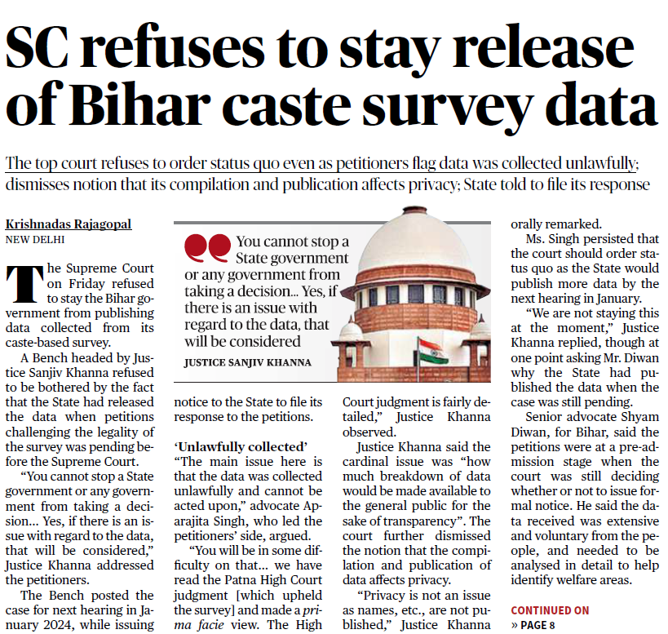
HEADLINES OF THE DAY
The Supreme Court on Friday refused to stay the Bihar government from publishing data collected from its caste-based survey.
Justice Khanna said the cardinal issue was “how much breakdown of data would be made available to the general public for the sake of transparency”. The court further dismissed the notion that the compilation and publication of data affects privacy.
“Privacy is not an issue as names, etc., are not published,” Justice Khanna orally remarked.
The Hindu; Polity

Slide 2
HEADLINES OF THE DAY
The Supreme Court on Friday refused to stay the Bihar government from publishing data collected from its caste-based survey.
Justice Khanna said the cardinal issue was “how much breakdown of data would be made available to the general public for the sake of transparency”. The court further dismissed the notion that the compilation and publication of data affects privacy.
“Privacy is not an issue as names, etc., are not published,” Justice Khanna orally remarked.
The Hindu; Polity

Slide 3
HEADLINES OF THE DAY
Imprisoned Iranian activist Narges Mohammadi won the Nobel Peace Prize on Friday in recognition of her tireless campaigning for women’s rights and democracy, and against the death penalty.
Ms. Mohammadi, 51, has kept up her activism despite numerous arrests by Iranian authorities and spending years behind bars.
She has remained a leading light for nationwide, women-led protests, sparked by the death last year of a 22-year-old woman in police custody.
The Hindu; Awards

Slide 4
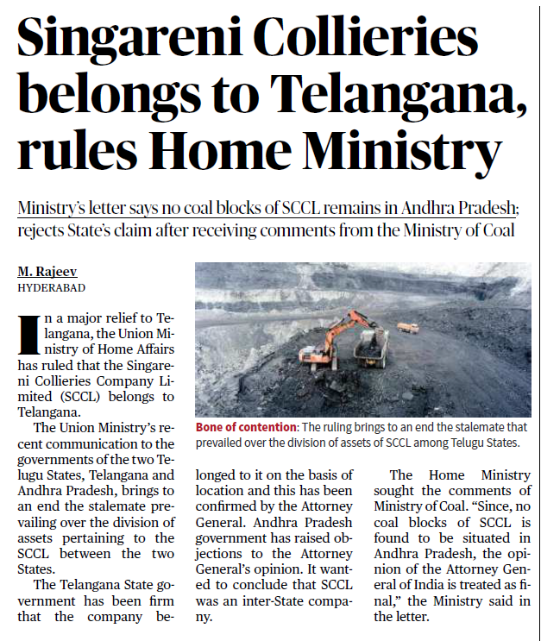
HEADLINES OF THE DAY
In a major relief to Telangana, the Union Ministry of Home Affairs has ruled that the Singareni Collieries Company Limited (SCCL) belongs to Telangana.
The Union Ministry’s recent communication to the governments of the two Telugu States, Telangana and Andhra Pradesh, brings to an end the stalemate prevailing over the division of assets pertaining to the SCCL between the two States.
The Telangana State government has been firm that the company belonged to it on the basis of location and this has been confirmed by the Attorney General. Andhra Pradesh government has raised objections to the Attorney General’s opinion. It wanted to conclude that SCCL was an inter-State company.
The Hindu; Polity and Governance

Slide 5
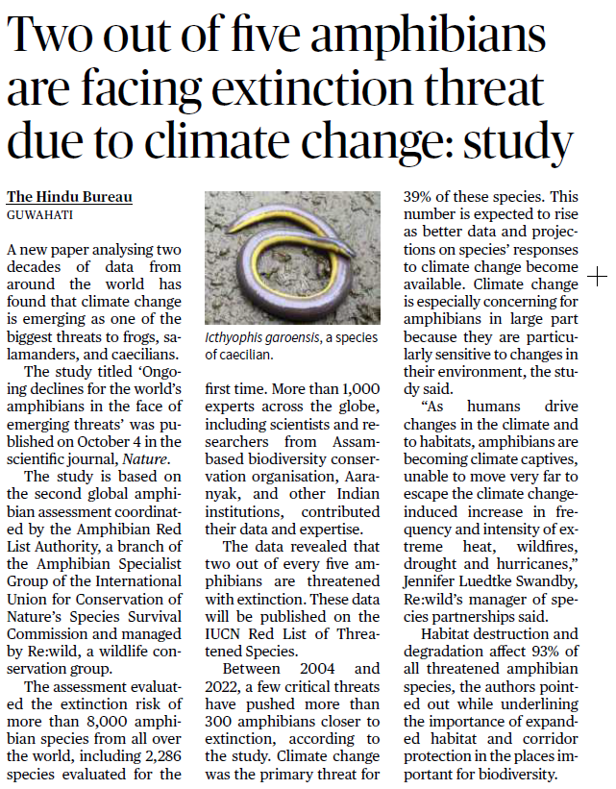
HEADLINES OF THE DAY
A new paper analysing two decades of data from around the world has found that climate change is emerging as one of the biggest threats to frogs, salamanders, and caecilians.
The study titled ‘Ongoing declines for the world’s amphibians in the face of emerging threats’ was published on October 4 in the scientific journal, Nature.
The assessment evaluated the extinction risk of more than 8,000 amphibian species from all over the world, including 2,286 species evaluated for the first time.
The data revealed that two out of every five amphibians are threatened with extinction.
The Hindu; Envmt

Slide 6
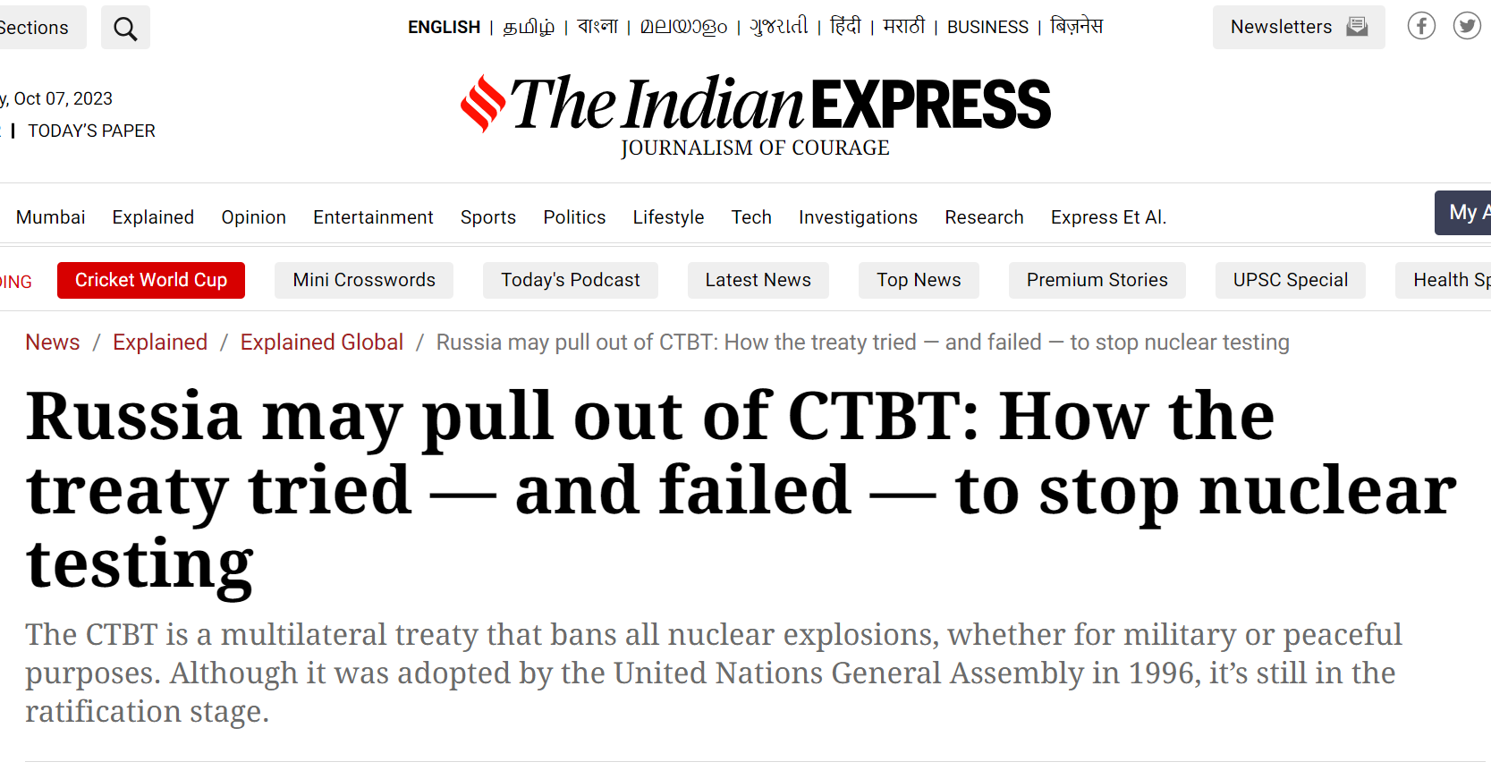
HEADLINES OF THE DAY
A day after indicating that Russia might revoke its ratification of the Comprehensive Nuclear Test Ban Treaty (CTBT), President Vladimir Putin said on Friday (October 6) that the country would do so to be on level terms with the United States, and not to resume nuclear testing.
The CTBT is a multilateral treaty that bans all nuclear explosions, whether for military or peaceful purposes.
Although it was adopted by the United Nations General Assembly in 1996, it’s still in the ratification stage — 18 countries are yet to ratify (the process by which a state indicates its consent to be bound to a treaty).
While Russia ratified the agreement in 2000, the US is still to do so.
Indian Express; IR

Slide 7
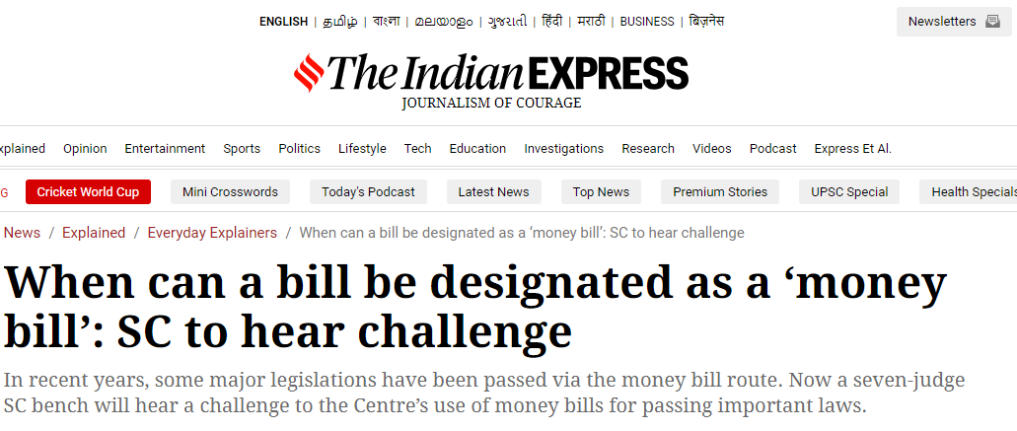
HEADLINES OF THE DAY
Chief Justice of India DY Chandrachud said on Friday (October 6) that a seven judge bench will soon be set up to hear a batch of pleas challenging the Centre’s use of the money bill route to pass certain key legislations.
Under Article 110(1), a Bill is deemed to be a money Bill if it deals only with matters specified in Article 110 (1) (a) to (g) — taxation, borrowing by the government and appropriation of money from the Consolidated Fund of India among others. A money Bill can only be introduced in Lok Sabha and does not need the consent of Rajya Sabha.
According to Article 110 (3) of the Constitution, “if any question arises whether a Bill is a Money Bill or not, the decision of the Speaker of the House of the People thereon shall be final.” However, the court in the Aadhaar case had said that the Speaker’s decision will be subject to judicial scrutiny.
Indian Express; Polity and Governance

